Slide 1
Efficient Estimation of Betweenness Centrality in Wireless Networks
Feb. 2016
Joo-Seong Heo
LINK@KoreaTech
http://link.koreatech.ac.kr

Slide 2
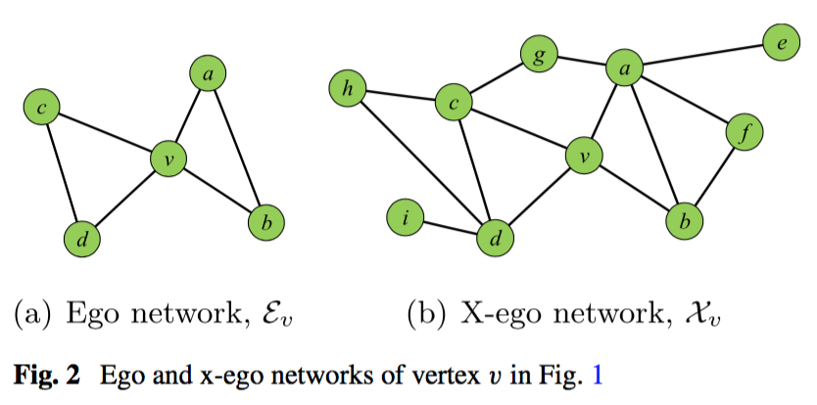
Contents
Ego Network
X-Ego Network
- Theorem 2
- Theorem 3
- Theorem 4
+ Algorithm

Slide 3
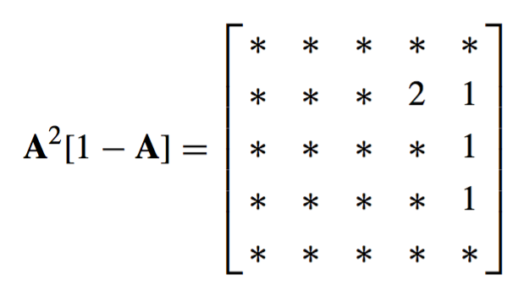
Ego Network
we define ego networks to be networks consisting of a single actor (ego) together with the actors they are connected to (alters) and all the links among those alters.
These networks are also known as the neighbourhood networks or first order neighbourhoods of ego.

Slide 4
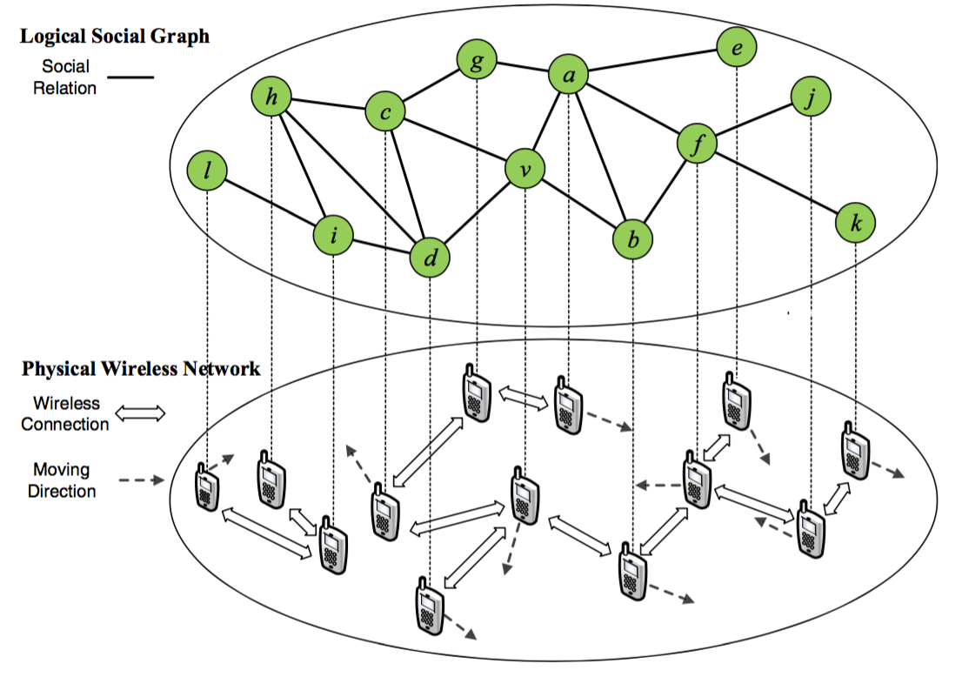
X-Ego Network
In wireless networks, the betweenness of a node has been considered an indication of that node’s importance in efficiently and reliably delivering messages.
we introduce a new representation of a node’s vicinity, called the expanded ego network (shortly, x-ego network) of that node.

Slide 5
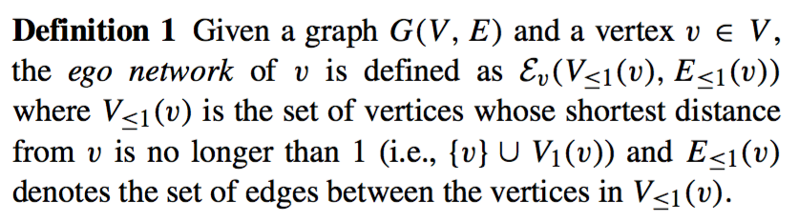
Definition 1

Slide 6
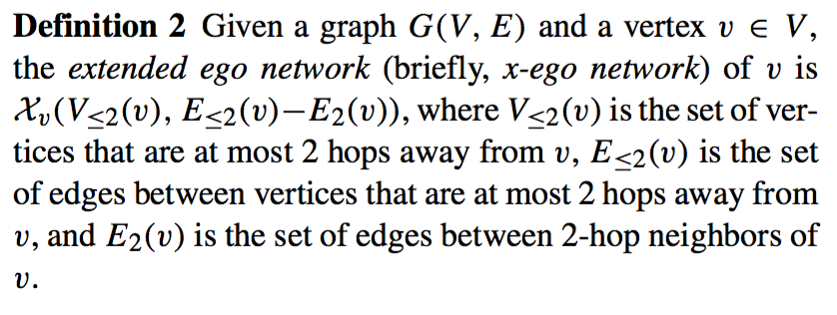
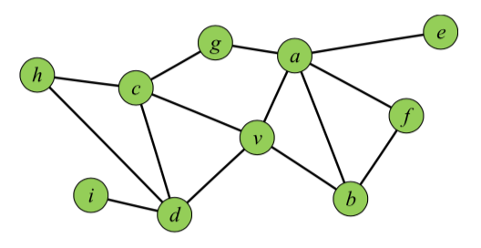
Definition 2

Slide 7
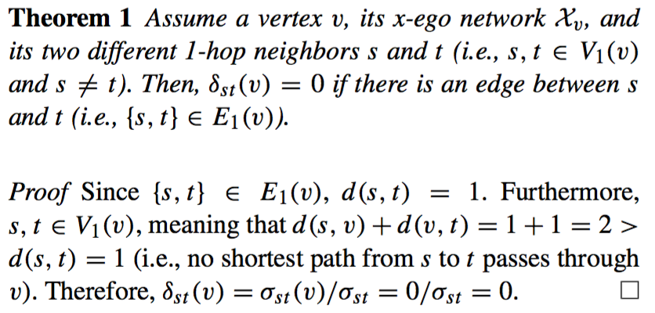
Theorem 1

Slide 8
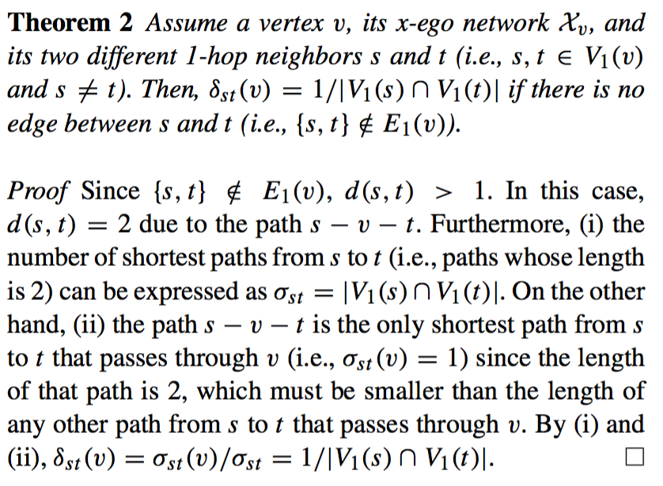
Theorem 2

Slide 9
Theorem 2

Slide 10
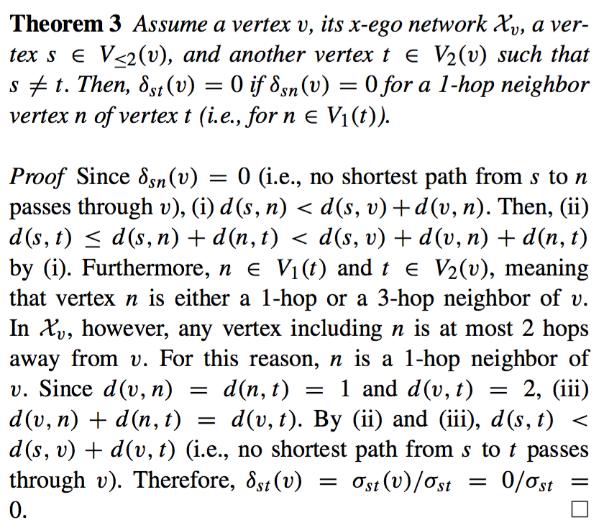
Theorem 3

Slide 11
Theorem 3

Slide 12
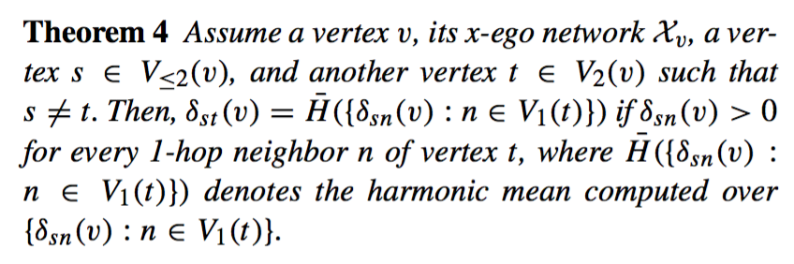
Theorem 4

Slide 13
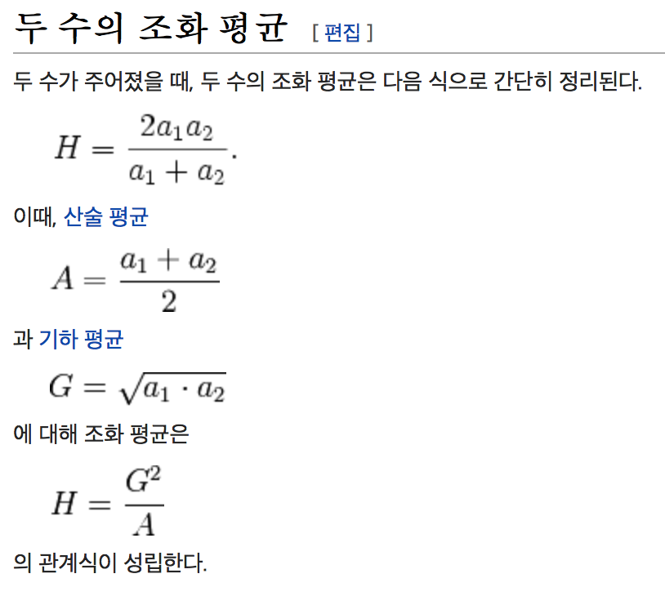
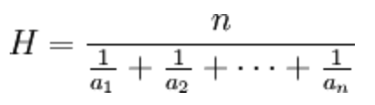
Harmonic mean
경우에 따라서 조화 평균이 정확한 평균치를 돌려준다.
예를 들어, 전체 거리의 절반을 40km/h의 속도로 달리고, 남은 절반을 60km/h로 달렸다면, 평균 속력은 40과 60의 조화 평균인 48km/h가 된다. 이동하는데 전체 거리를 48 km/h의 속력으로 달린 경우와 같은 시간이 걸렸기 때문이다. (만약 전체 "시간"의 절반씩을 달렸다면, 평균 속력은 산술 평균인 50km/h가 된다.)
일이나 능률
평균적인 변화율
주어진 수들의 역수의 산술 평균의 역수

Slide 14
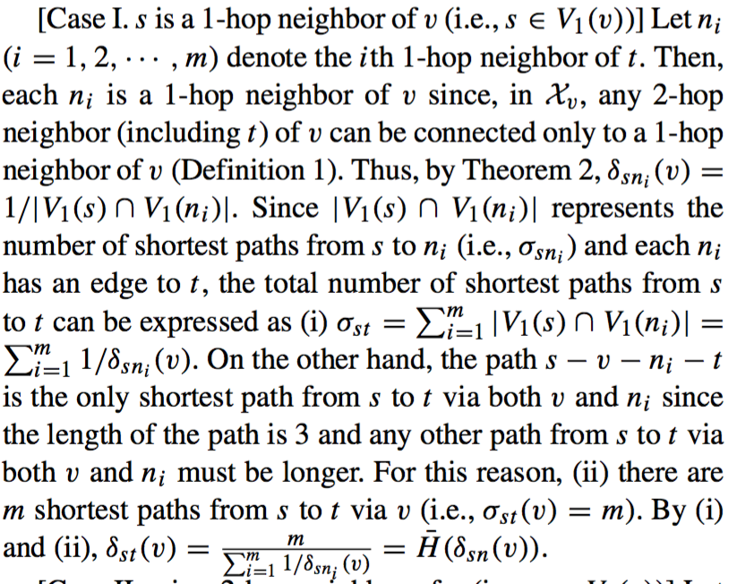
Theorem 4

Slide 15
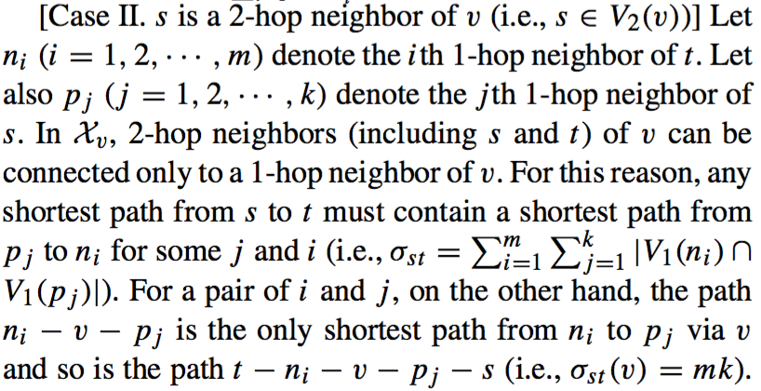
Theorem 4

Slide 16
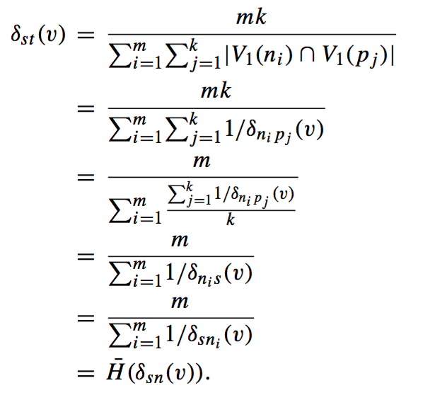

Theorem 4

Slide 17
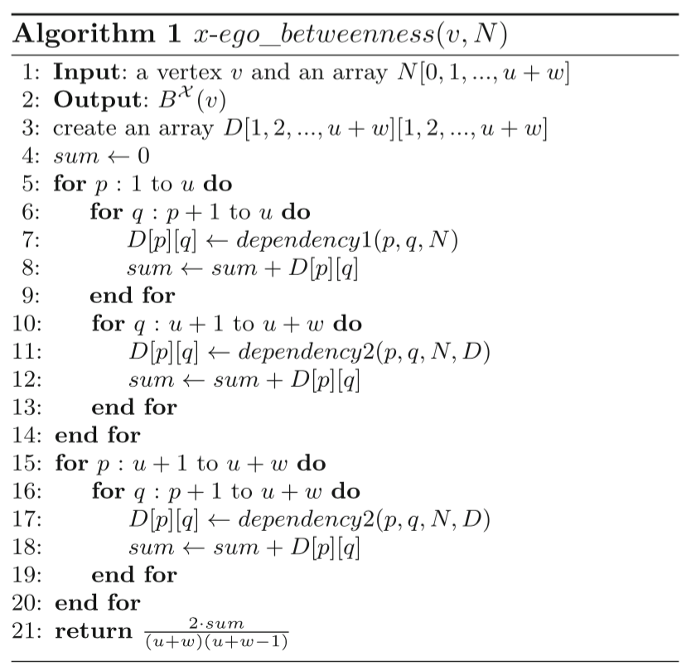
Algorithm 1
v : Ego
N : Node
u : 1- hop
w : 2- hop
p,q : s,t

Slide 18
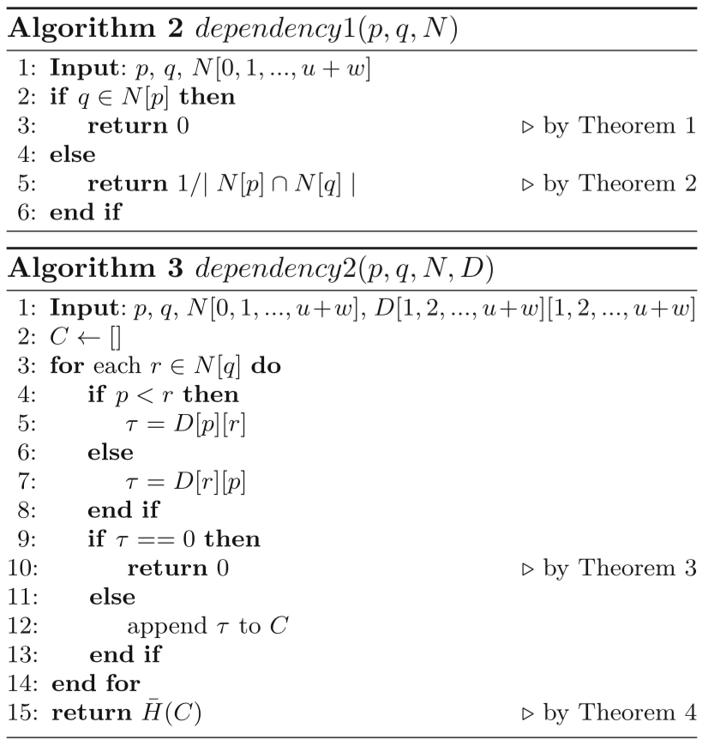
Algorithm 2, 3
r : Ego
N : Node
u : 1- hop
w : 2- hop
p,q : s,t

Slide 19
Thank you

